Slide 1
Heap- Data Structure

Slide 2
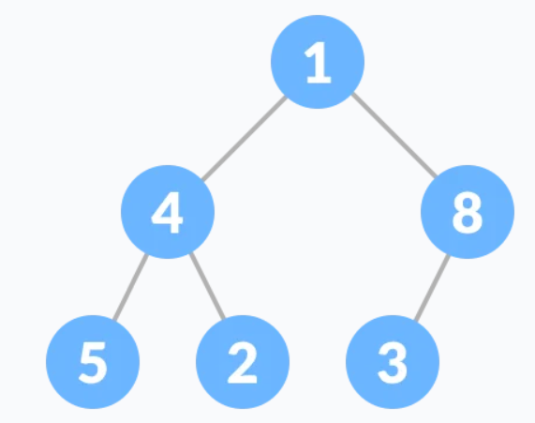
Heap
A Heap is a special Tree-based data structure in which the tree is a complete binary tree.
Heaps are of two types-min heap and max heap
What is a complete binary tree?
A complete binary tree is a special binary tree in which
every level, except possibly the last, is filled
all the nodes are as far left as possible

Slide 3
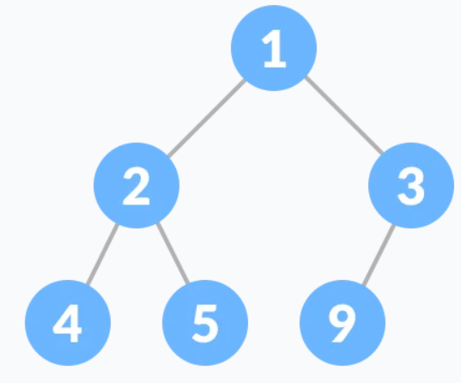
Min heap
(for min heap) value of each node is always smaller than the child node/s and the value of the root node is the smallest among all other nodes.

Slide 4
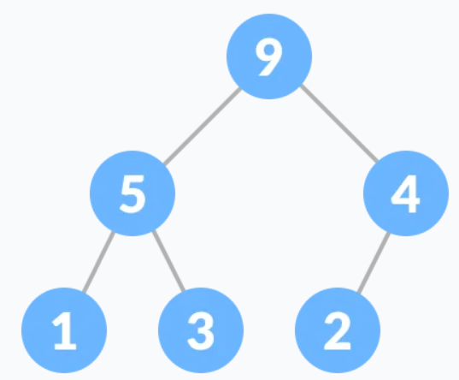
Max heap
(for max heap) value of each node is always greater than its child node/s and the key of the root node is the largest among all other nodes

Slide 5
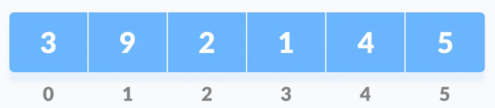
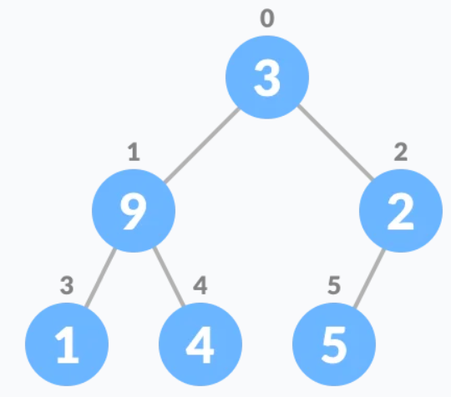
Heapify- Converting a given array into heap
Insert array from left to right in a tree

Slide 6
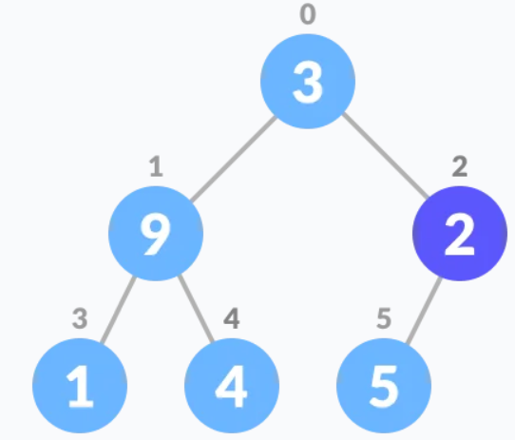
Then we start from the index n/2-1, which always points to last node of second last level of tree
For max heap, syntax is
set the current element at index i as largest
The index of left child and right child will be 2i+1 and 2i+2
If leftchild>current element, set left child as largest. If rightchild>current element, set right child as largest.
Swap largest with current element.
i=i-1 and repeat till we reach root node
For min heap we compare the smallest number

Slide 7
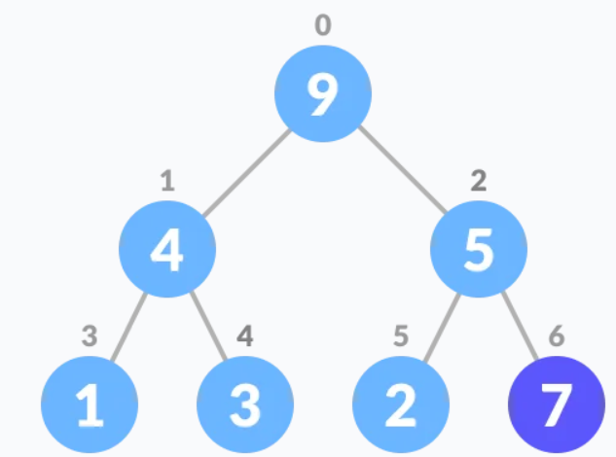
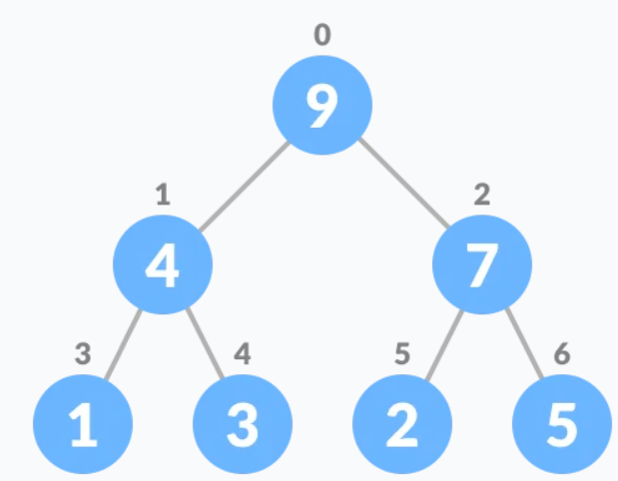
Insert element in heap
1. Insert element at the end of tree
2. Heapify the tree

Slide 8
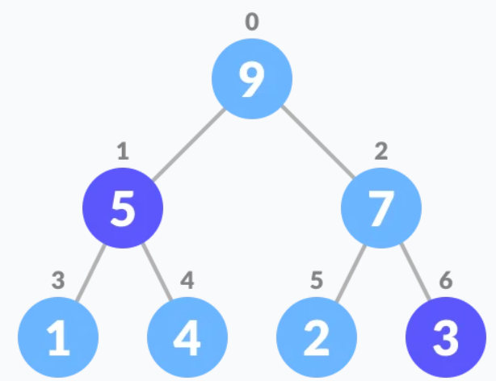
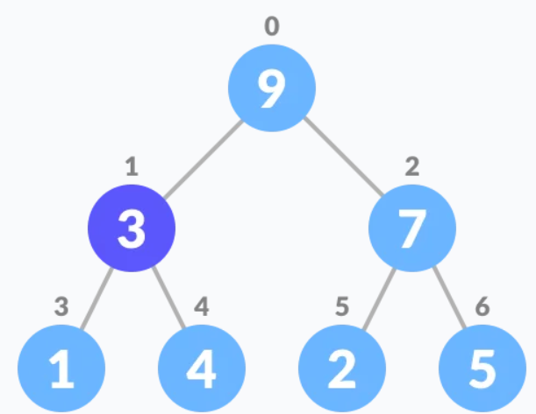
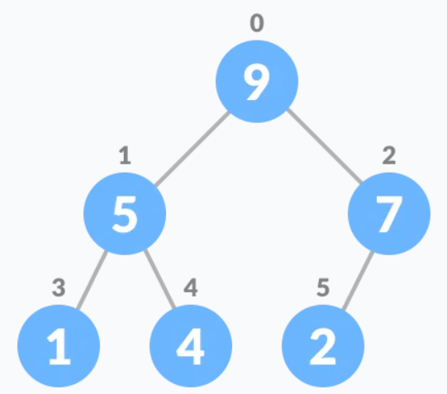
Deletion in heap
2. Swap with the last element and remove the last element
1. Select the element to be deleted
3. Heapify the tree

Slide 9
Very easy to implement in python ! Module named heapq in python :D
heapq.heapify(iterable): turns an array into a heap. By default it will be min heap.
heapq.heappush(heap, ele): inserts the element in heap and performs heapify automatically to maintain heap structure.
heapq.heappop(heap): will remove the smallest integer from heap and performs heapify automatically to maintain heap structure.
heapq.heappushpop(heap, ele) :- This function combines the functioning of both push and pop operations in one statement, increasing efficiency. Heap order is maintained after this operation.
heapq.heapreplace(heap, ele) :- This function also inserts and pops element in one statement, but it is different from above function. In this, element is first popped, then the element is pushed .i.e, the value larger than the pushed value can be returned. heapreplace() returns the smallest value originally in the heap, where heappushpop() will first push the element and then pop the smallest element.

Slide 10
Very easy to implement in python ! Module named heapq in python :D
nlargest(k, iterable, key = fun) :- This function is used to return the k largest elements from the iterable specified and satisfying the key if mentioned.
nsmallest(k, iterable, key = fun) :- This function is used to return the k smallest elements from the iterable specified and satisfying the key if mentioned.

Slide 11
Implement max heap using heapq
Since using heapq.heapify(iterable) returns min-heap by default, there has to be an alternative for implementing max-heap
From the answers I saw, simply multiplying the array by -1 will convert the maximum to minimum and vice versa, and making it a max-heap.. Just in negative.
Just before popping, pushing or returning a value, multiply the number again with -1 to get the original number

Slide 12
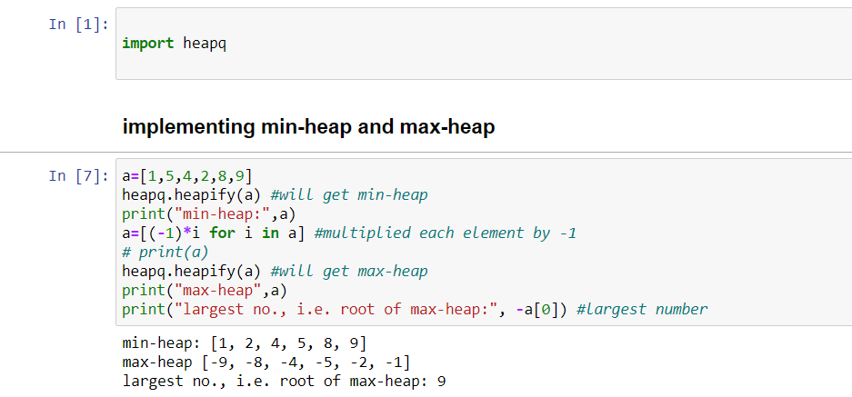
Implement min heap and max heap using heapq

Slide 13
HEAP SORT
To get an array sorted in ascending order:
Since the tree satisfies Max-Heap property, then the largest item is stored at the root node.
Swap: Remove the root element and put at the end of the array (nth position) Put the last item of the tree (heap) at the vacant place.
Remove: Reduce the size of the heap by 1.
Heapify: Heapify the root element again so that we have the highest element at root.
The process is repeated until all the items of the list are sorted.

Slide 14
Where is heap data structure used?
Heaps are used in many famous algorithms such as Dijkstra's algorithm for finding the shortest path, the heap sort sorting algorithm, implementing priority queues, and more. Essentially, heaps are the data structure you want to use when you want to be able to access the maximum or minimum element very quickly.

